Slide 1
竞品分析

Slide 2
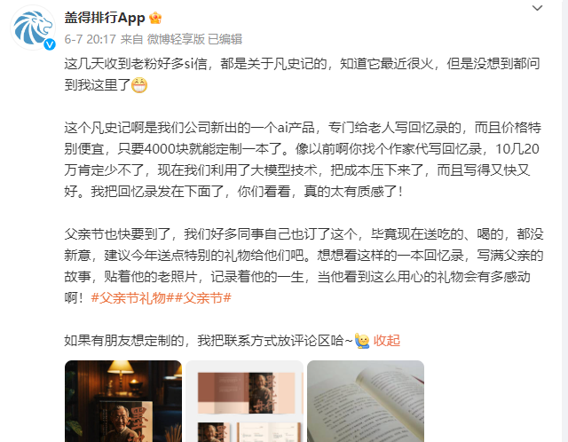

Slide 3


Slide 4
凡人记
https://weibo.com/n/%E7%9B%96%E5%BE%97%E6%8E%92%E8%A1%8CApp

Slide 5
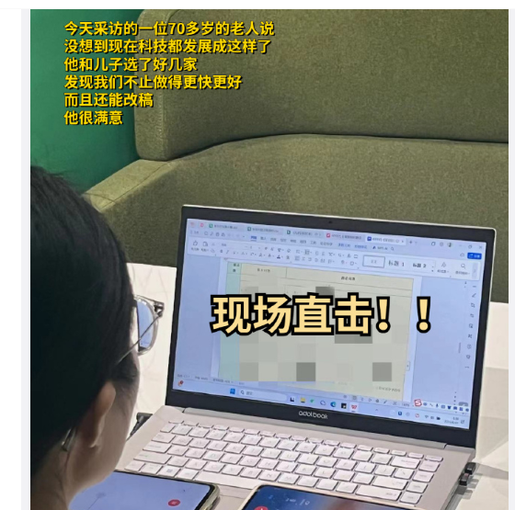
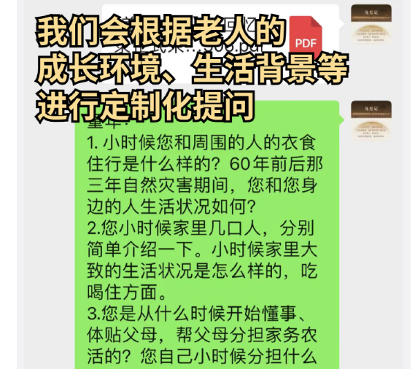
线上和线下访谈

Slide 6
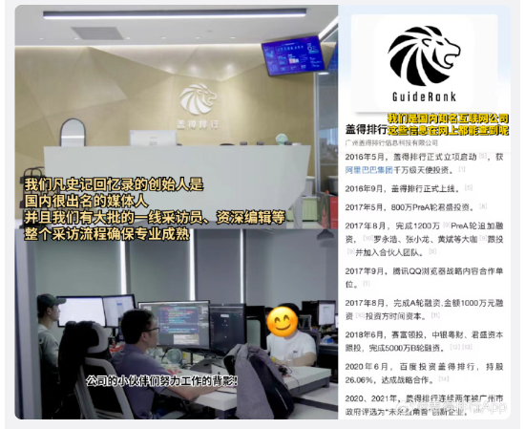


Slide 7



Slide 8
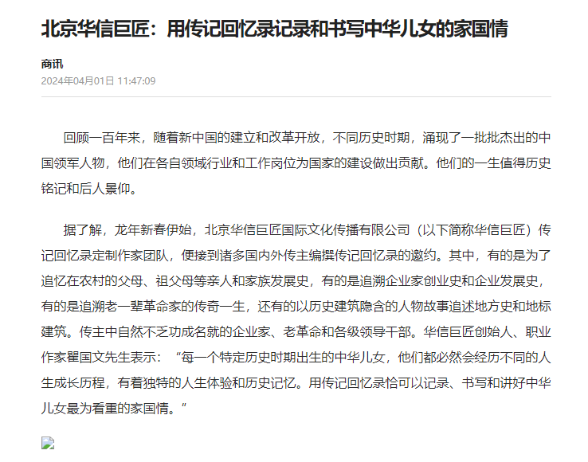

Slide 9


Slide 10
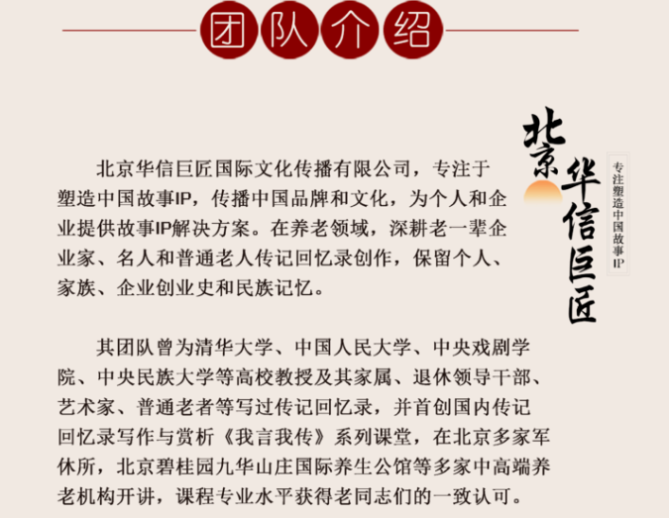

Slide 11
